Slide 1
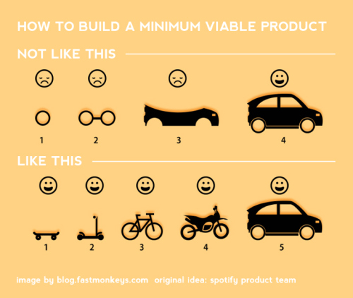

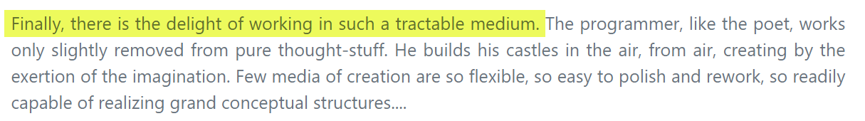
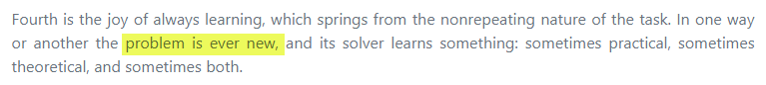
CS2103/T [Jan 2025]
Week 2→3 Briefing
[60 minutes]
Instructions for this lecture:
Ensure your Zoom name matches the one in your student card. (for participation tracking)
When answering a question I asked, send as a private message to me.
When asking a question from me, use Zoom Q&A feature (not the normal chat).
For urgent issues unmute and speak e.g, if I seem to be pointing at something on the slide but you don’t see my laser pointer on screen
i. Which one illustrates the breadth-first iterative approach? (send answer as a private Zoom message, to Damith)
Depth-first iterative
(a)
Breadth-first iterative
(b)
iv) Which is the best for software projects?
Sequential/ waterfall
(c)
ii. Which is likely to be used when a car manufacturer builds a new type of a car?
iii. Which would you use if you were asked to build a new type of a car?
In software projects, (b) is possible and sometimes necessary, because …
Seen these before?
Example adapted from a presentation by Spotify

Slide 2
In our tutorials (even in F2F ones), when the tutor asks a question, all students use Zoom private messages to submit the answer. This way, everyone gets to think and answer questions without being influenced by others’ answers.
Next week’s tutorial will be a mass tutorial via Zoom (due to holidays) i.e., 400+ students sending private messages to one person. We wish to do a dry run today, to see if Zoom can scale up to a such high volume of private messages.
So, I will ask you questions at times (like I did in the previous slide), and you should send your answer as a private message too. We’ll count these towards bonus participation marks.
Instructions for this lecture:
Ensure your Zoom name matches the one in your student card. (for participation tracking)
When answering a question I asked, send as a private message to me.
When asking a question from me, use Zoom Q&A feature (not the normal chat).
For urgent issues unmute and speak e.g, if I seem to be pointing at something on the slide but you don’t see my laser pointer on screen
Pretend you are the only student in the class, and I’m taking directly to you ☺

Slide 3
Weekly lecture briefing structure
Recap of the last week
+
Preview of the next week

Slide 4
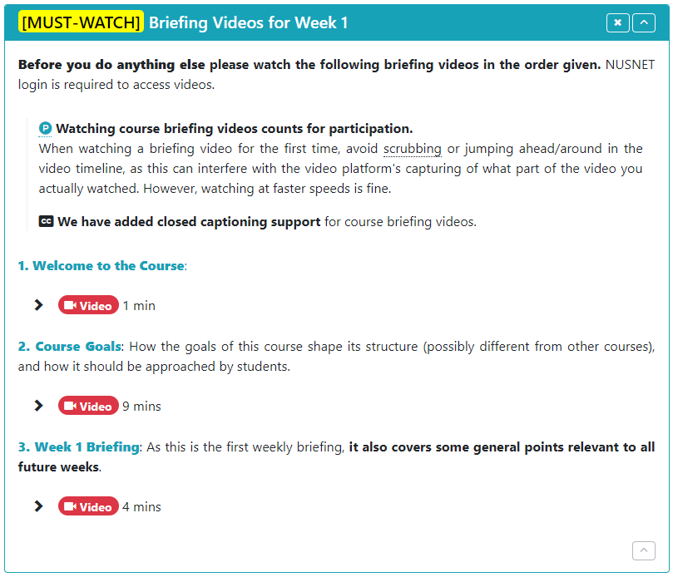
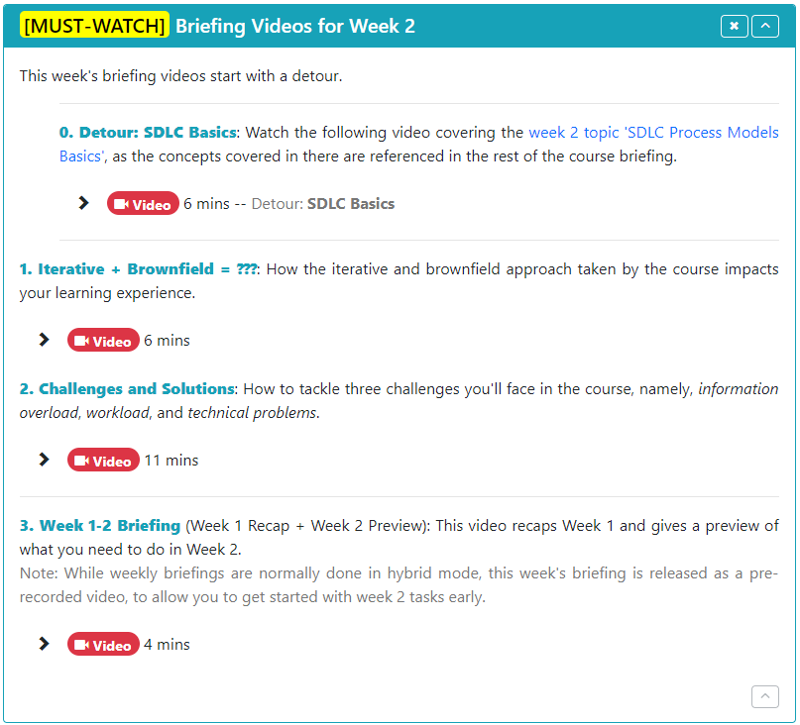

Slide 5
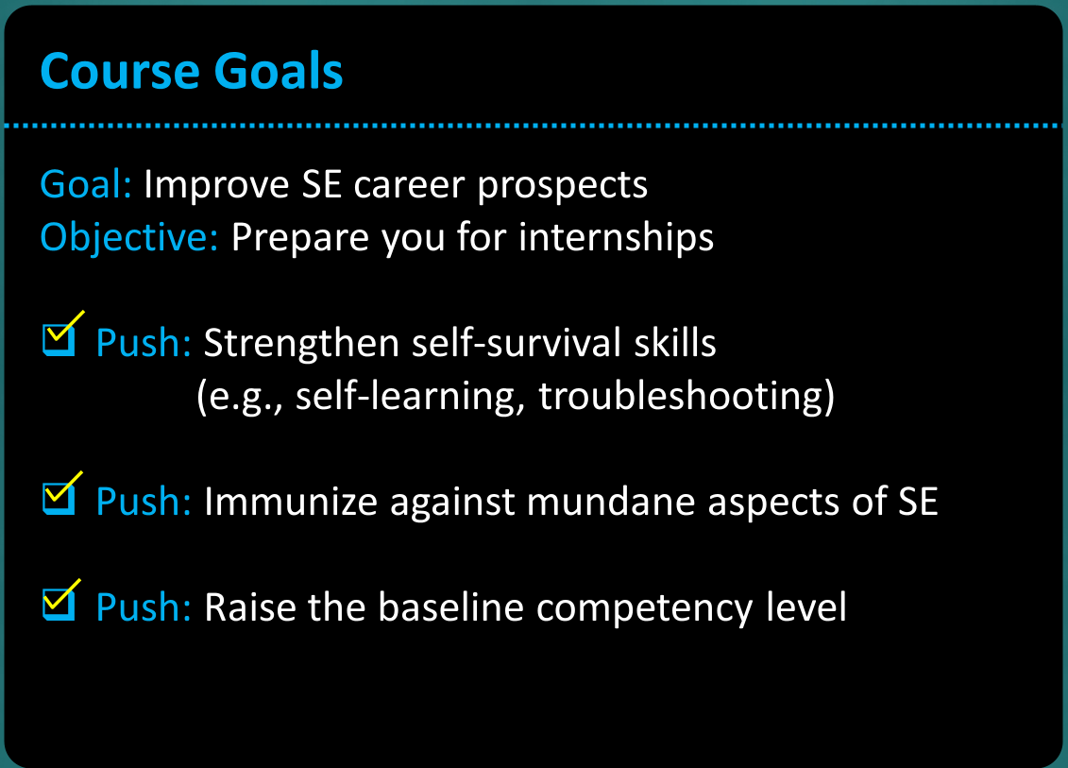

Slide 6
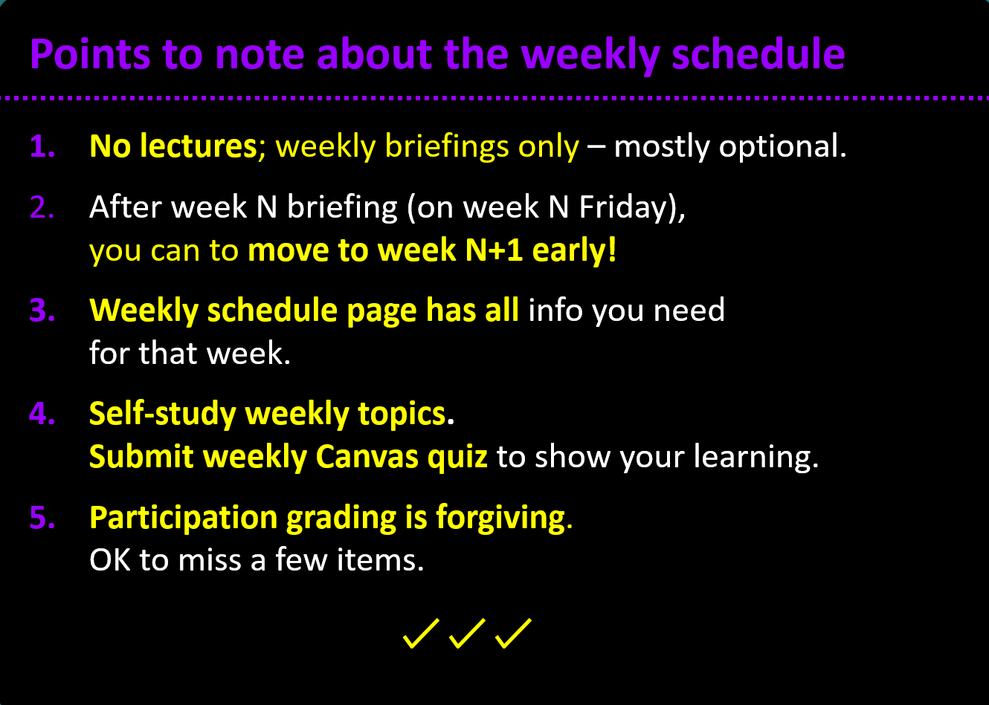

Slide 7
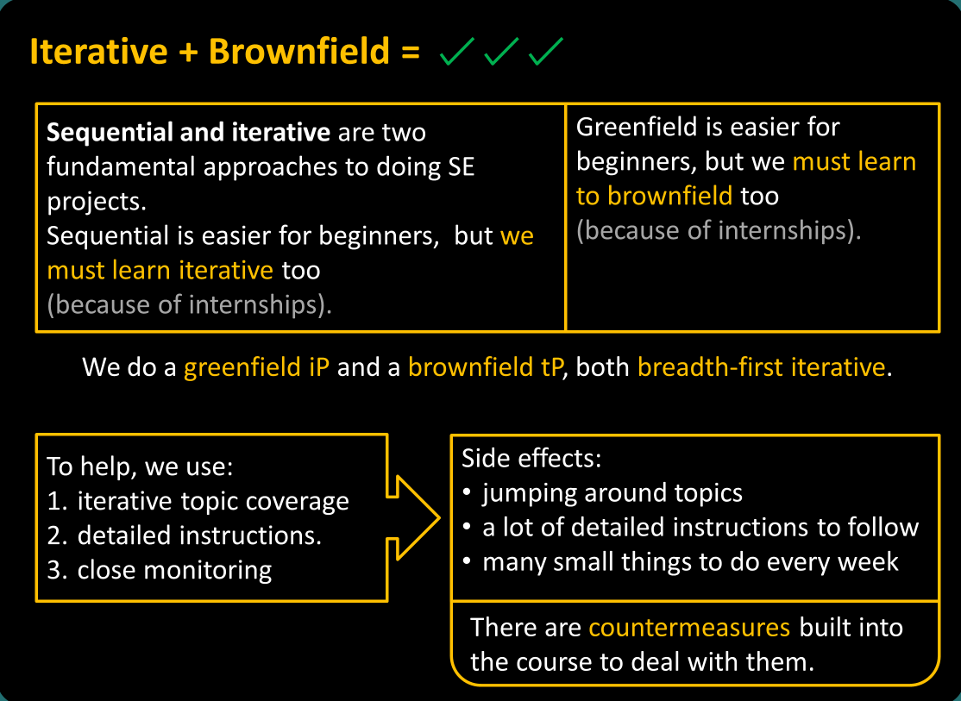

Slide 8
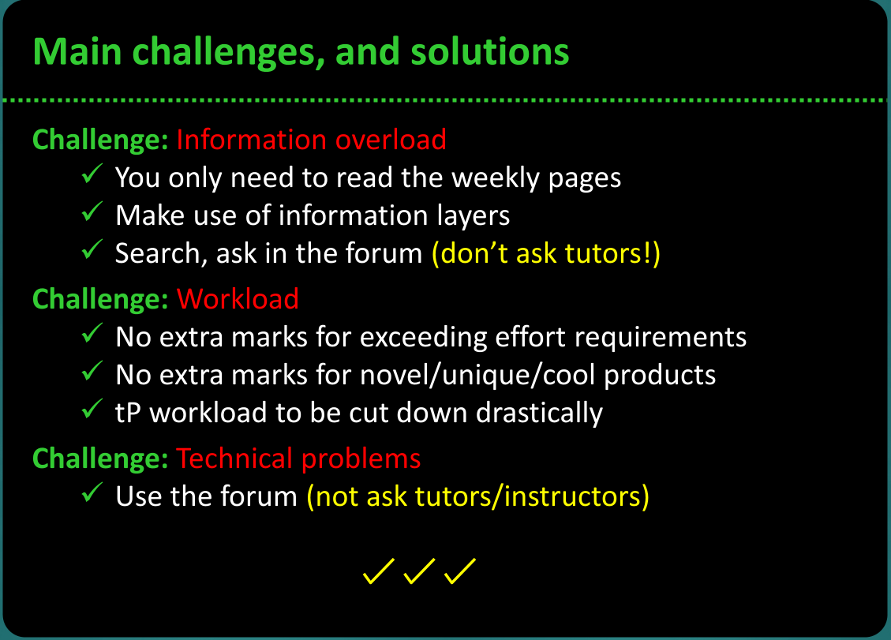

Slide 9
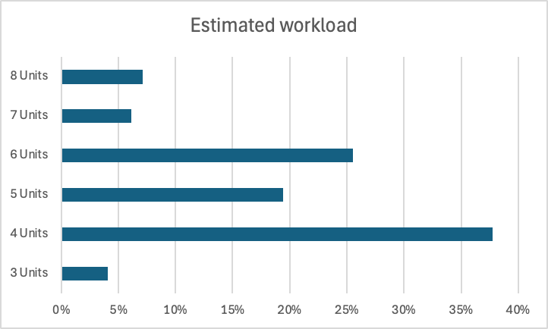
Anonymous post-course survey results
Compared to other 4-Unit courses, the workload of this course is equivalent to ...
Possible reason 1: Doing more than needed.
Don’t, unless you can afford it.
Why some students are in this range?
Possible reason 2: Lack of programming skills
Good! You can get more out of this course (compared to strong programmers).
Possible reason 3: Taking shortcuts to save time/effort and ending up wasting more time/effort.
Follow instructions, follow the schedule, and you’ll be fine.

Slide 10
Go to Canvas → Week 3 Quiz
About ‘in-briefing questions’:
Weekly Canvas quiz has a section for in-briefing questions.
These questions will be discussed during the briefing. You can enter the answer into Canvas during the briefing (or when watching the recording).
They are bonus questions. No penalty if you don’t answer them.
Your answers are auto-saved. Don’t click the ‘Submit’ button yet.
Later, answer the remaining questions (which are based on weekly topics), and submit the quiz.
Slides with such questions have a special sound effect, to alert you.
1
Which videos are compulsory to watch?
W1 briefing videos labelled as MUST-WATCH
W2 briefing videos labelled as MUST-WATCH
Future briefing videos labelled as MUST-WATCH
Zoom recording of this weekly briefing
Zoom recording of future weekly briefing
Videos given with textbook topics

Slide 11
Any value in paying attention to weekly briefing videos?
Divided students into clusters based on their final marks (reason: to compare results among students of similar academic strength).
Removed students who did not answer in-lecture quizzes (reason: to remove the influence from quizzes).
In each cluster, we compared the average marks between these two categories:
Students who attended the briefing live or watched the video (i.e., paid attention to briefing videos)
Students who simply skipped ahead in the video to find answers to in-lecture questions (i.e., didn’t pay attention to briefing videos)
Possible reason: weekly briefings revisit important parts of topics, which are also likely to be tested in the exam.
Typically, group A scored 1.5-2.5 marks higher than group B

Slide 13
Init
Fork
Clone
Commit
Tag
Pull
Push

Slide 14

sync fork (new feature)
Repo on remote server
repo copy on GitHub
GitHub
fork or clone?
(fork)
[upstream]
[origin]
push?
push
pull
push
clone
commit
Add remote
Local repo
Local repo
init
View from the top
You
Duke dev

Slide 15

> git make a mess
> git try to recover
> git start over
ask AI, ask in the forum, …
If you worry that you’ll make things worse, take a backup of the folder first
This works because all meta-data of the repo is stored inside the repo folder itself.

Slide 16
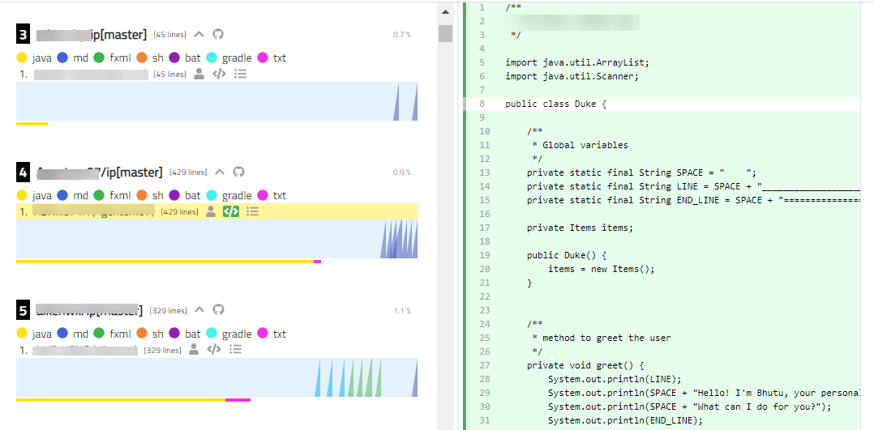
Worried about grading?
We don’t actually check/grade your code at every tag.
Want to know if there are others ways to code something?
Use the iP code dashboard (or raise in the forum)
Or ask ChatGPT

Slide 17
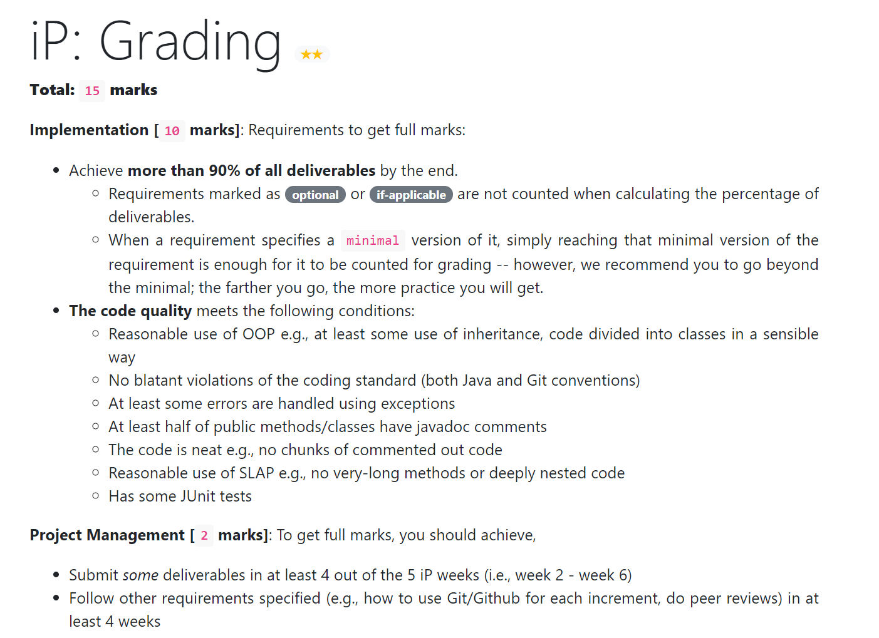
Some iP tips
It’s meant as a training exercise.
Objective: to help you level-up skills, not to differentiate based on skill level (i.e., formative, not summative)
No penalty for making mistakes, if you learn from them, and rectify quickly.

Slide 18
Answer this question in Week 3 Quiz (on Canvas)
2
Almost all are expected to score full marks for the iP.
True
False
Grading is more like S/U.

Slide 19
Some iP tips
Longer-term value beyond marks:
Practice skills, learn tools (for the tP, and beyond)
weak programmer? catch up
strong programmer? go deeper, help others
Use it to strengthen your resume
Make the product your own
Make it stand out
iP is a full product!

Slide 20
3
In the iP, you are encouraged to follow the given command input/output formats closely.
True
False

Slide 21
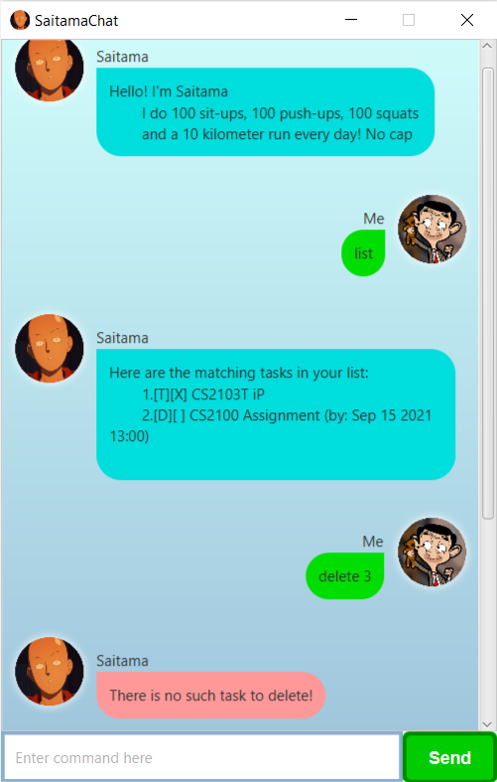
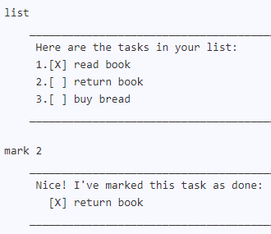
Recommended: Come up with a good design that can support all iP increments indicated for future weeks.
True
False
4
Don’t forget to go breadth-first iterative: assume the future is unknown
(bonus: more practice + more experience → higher competence)

Slide 22


Slide 23
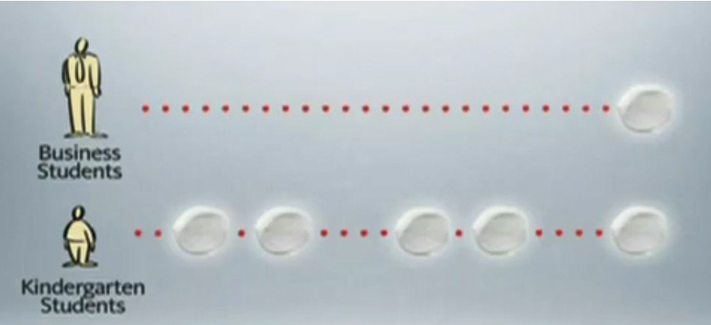
Always keep the marshmallow on the top!
Solving small scale algorithm problems:
Analyze the problem
Design a solution (as pseudo code?, diagram?)
Verify the solution for correctness
Compare with alternatives
Sure of the solution? Now, write the code.
Creating bigger software:
Start with the smallest code that works 5 lines? Just an empty main method?
Do a small change to move it towards end goal. Verify it still works. 5 more lines?
Keep repeating the above step.
Took a few wrong steps? Just undo them.
When thing get messy, clean up, in small steps.

Slide 24
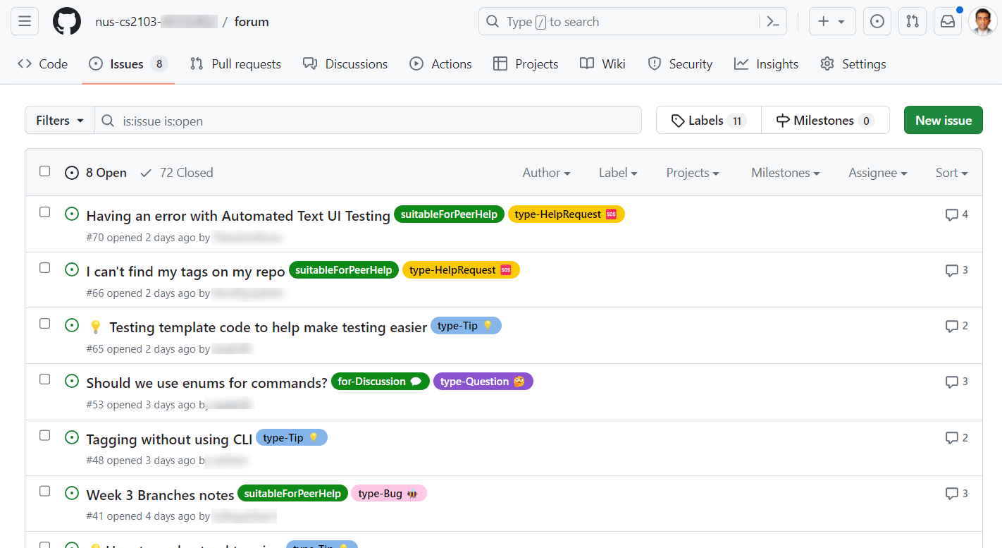
Bonus participation marks for forum activities

Slide 25
Lecture briefing structure
Recap of the last week
+
Preview of the next week

Slide 26

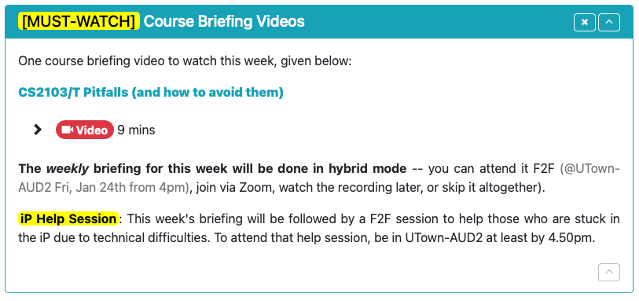
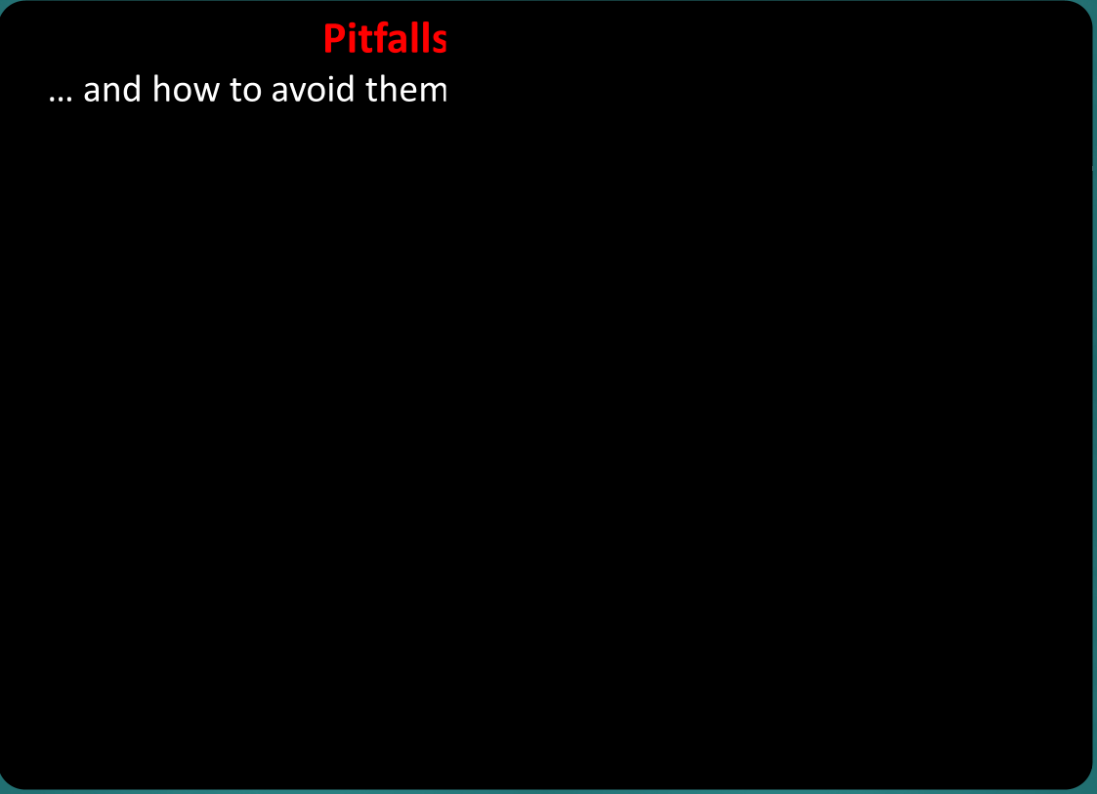
One more course briefing video in this week …
Welcome
Goals
Iterative + Brownfield = ???
Challenges
Pitfalls
tP (parts: 1, 2a, 2b)
Topics Recap
Exam

Slide 28
Pull Request
???
Repo on remote server
Forked repo on GitHub
fork
GitHub
pull
branching
push
push
clone
Local repo
e.g., comparing alternative implementations
Local repo
init
commit
Duke dev
You

Slide 32
An example commit message adapted from Addressbook-Level1
Commit message subject is one of the first things someone will notice when you submit code
When merged, this commit will
Stated in the imperative mood
Update Developer Guide to use Java 17
--- [blank line] ----
The Developer Guide instructs users to use Java 11 or later. The code is already compatible with Java 17.
Since AddressBookL4 is already using Java 17, this project has become inconsistent with AB-4.
Let’s update the Developer Guide to mention using Java 17 or later.
Subject
Current state
What’s wrong with the current state
How this commit changes the current state
Other relevant info e.g., references

Slide 33
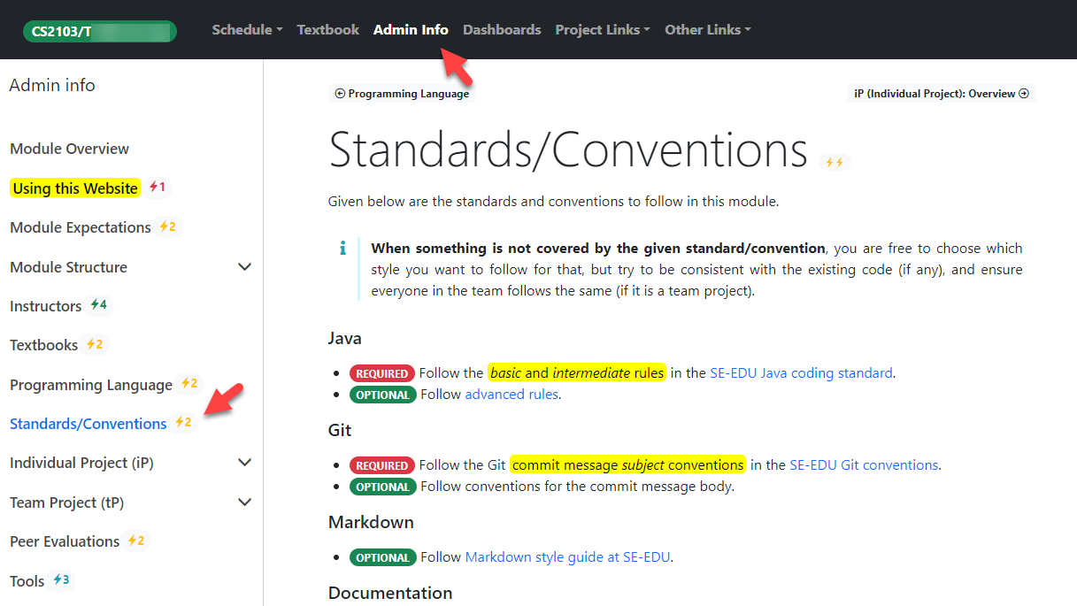
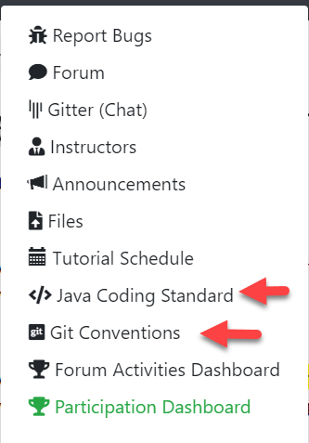

Slide 34
5
Must-do in the iP:
Follow the given Git convention for future commit message subject
Follow the given Git convention for future commit message body
Modify past commits to comply with the given Git conventions
Yes, it is possible to change past commits.
Pushing edited commits might require a force-push.
Not recommended if you have pushed those commits to a remote repo already, and others have pulled them.

Slide 35





Slide 36



Slide 37





1.1 million users
150,000 Lines of Code
500+ student developers

Slide 38
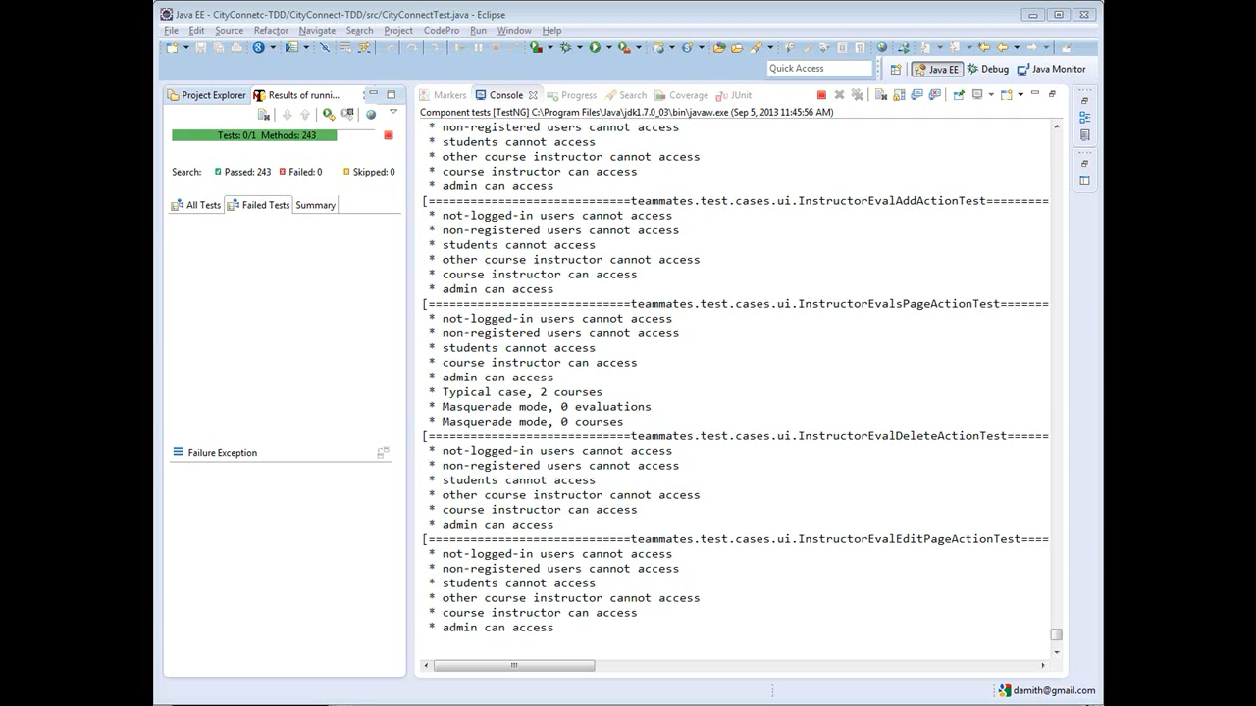

Slide 39
Automated tests

Slide 41
Serves as an anchor point to stabilize the rhythm of the iterations
No need to decide on a project yet though.

Slide 42
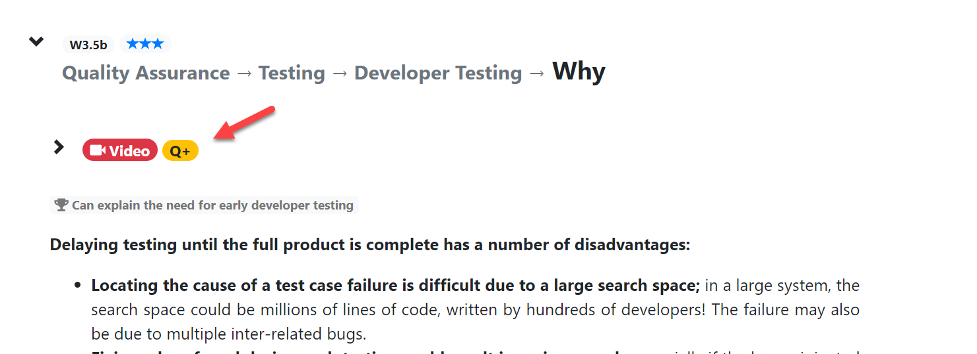
Some topic videos have in-video quizzes

Slide 43
Tutorial mode
First 2 weeks: fully online (Zoom).
2 tutors (10 students each) in each tutorial slot.
Everyone is expected to answer questions posed by the tutor (more about this policy in next week).
Moving to F2F later. More info to come later.

Slide 44
iP Help Session
Anybody here to help others?
Anybody needs Mac-specific help?
Anybody else seeking help?

Slide 45
